Slide 1
Interviewing for data science
Jeff Leek
@jtleek
www.jtleek.com

Slide 2
Structure of an interview
Individual meetings
Demonstration/presentation
Evaluation of technical skills

Slide 3

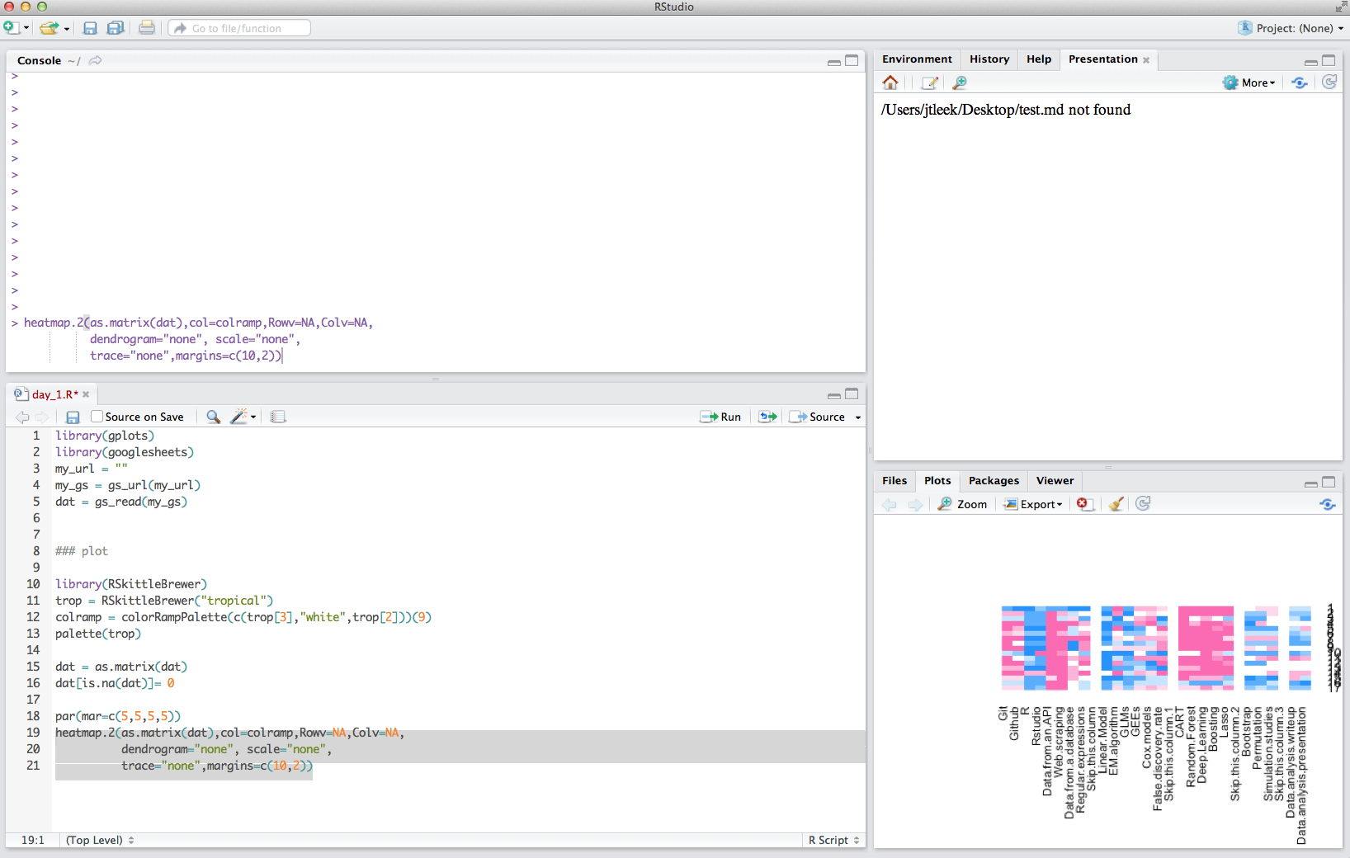
Image source: http://bit.ly/1FzzAaP
Presentation
(2)
Individual meetings
Skills assessment
(3)

Slide 4
Individual meetings
Focus on projects
Interpersonal skills are critical
Focus on global evaluation of skills
Conceptual understanding

Slide 5
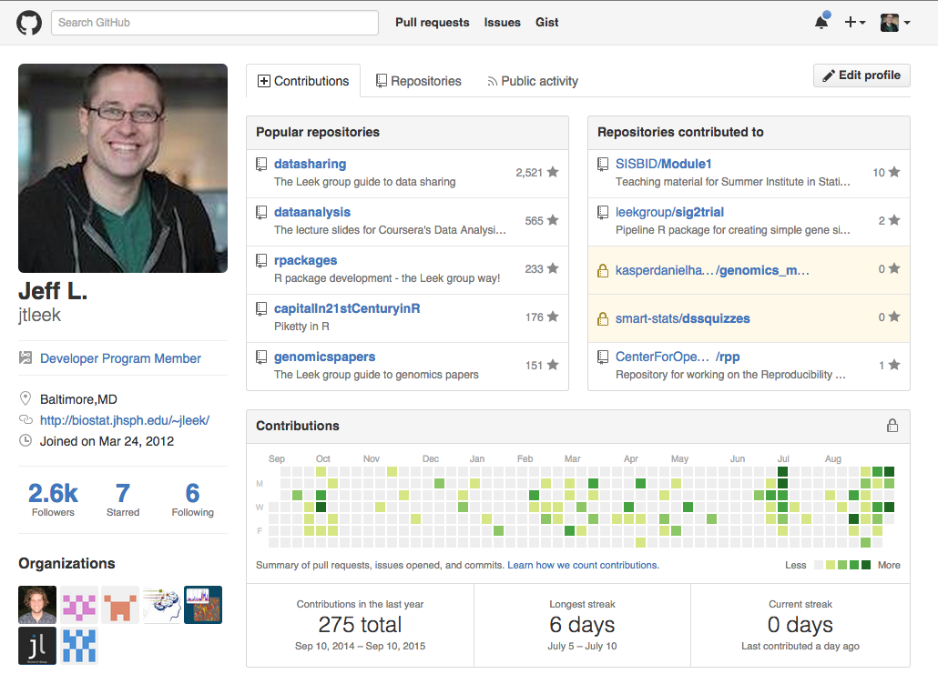
Individual meetings

Slide 6
Demonstration or presentation
Opportunity to show creativity
Communication skills check
Opportunity to interact

Slide 7
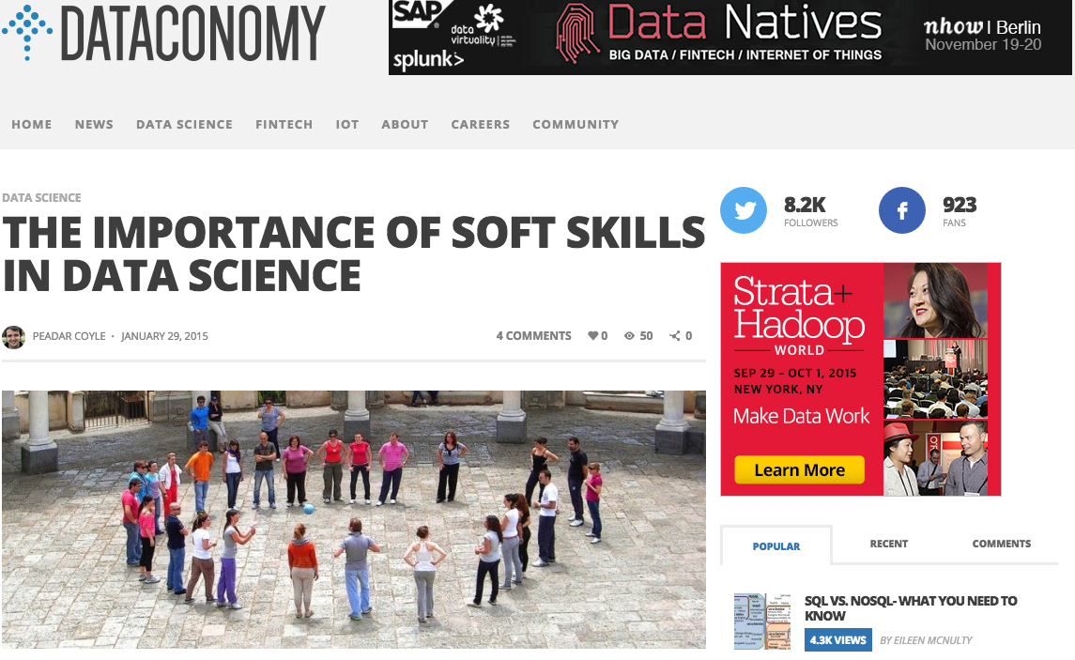
http://dataconomy.com/the-importance-of-soft-skills-in-data-science/
Presentation
(2)

Slide 8
Evaluation of technical skills
Focused practical problem
Follow up discussion

Slide 9
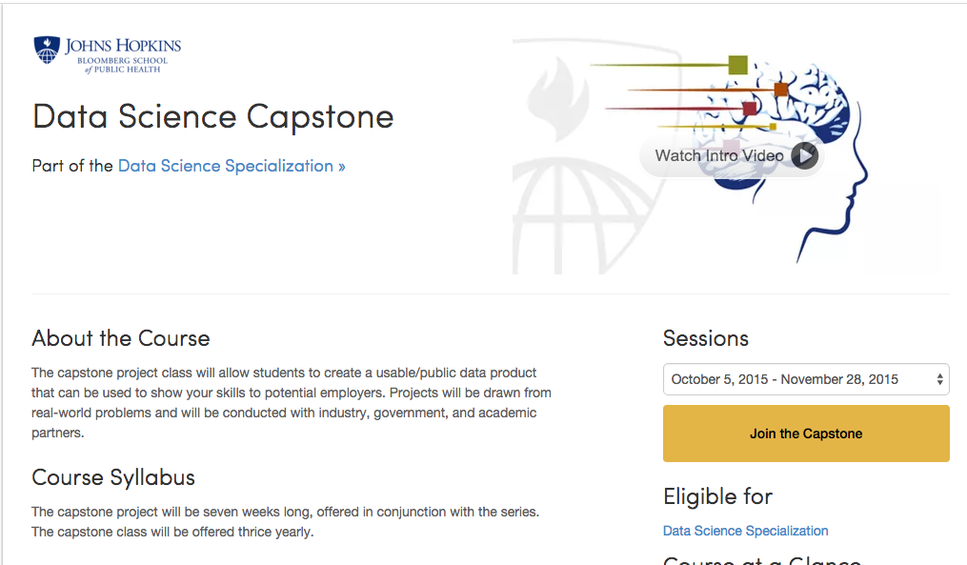
https://www.coursera.org/course/dsscapstone
Skills assessment
(3)

